Slide 1

SEASONAL AGRICULTURE PERFORMANCE ANALYSIS
STUDENT NAME : NISHA R
AICTE STUDENT ID : STU6a6b5fa76dafc1785421735
COLLEGE NAME : RAMCO INSTITUTE OF TECHNOLOGY

Slide 2

PROBLEM STATEMENT
Agricultural performance is influenced by seasonal variations in environmental conditions, farming practices, resource availability and market conditions.
However, raw agricultural data does not clearly explain:
How agricultural performance varies across seasons
Which seasonal patterns are significant
How environmental conditions affect outcomes
How resource usage changes between seasons
How economic performance varies
Whether seasonal patterns differ across regions and crops
Therefore, this project analyses agricultural data to identify meaningful seasonal patterns, relationships and variations and derive evidence-based insights for better agricultural planning.

Slide 3
PROJECT DESCRIPTION
This project performs an end-to-end analysis of agricultural activities across different seasons using data analytics techniques.
The analysis covers:
🌾 Crop and agricultural performance
🌦️ Environmental conditions
💧 Water and resource utilization
🧪 Fertilizer and pesticide usage
🌱 Soil characteristics
📈 Yield and production
💰 Cost, revenue and profit
🗺️ Regional variations
⚠️ Disease and pest risk
The project transforms raw agricultural data into seasonal insights, performance comparisons and data-driven recommendations.

Slide 4

WHO ARE THE END USERS?
Farmers 🌾
Understand seasonal crop performance
Plan resources such as water and fertilizer
Agricultural Planners 📊
Compare agricultural performance across seasons and regions
Support seasonal resource and production planning
Agricultural Researchers 🔬
Study relationships between environmental conditions, farming practices and agricultural outcomes
Identify seasonal patterns for further research
Agricultural Organizations / Departments 🏛️
Use data-driven insights for agricultural planning and resource allocation
Identify regions or seasons requiring attention

Slide 5

TECHNOLOGY USED
Python – Main programming language for data analysis.
Pandas
NumPy
Matplotlib
Seaborn
SciPy
Google Colab
GitHub – Version control and project/code repository.

Slide 6
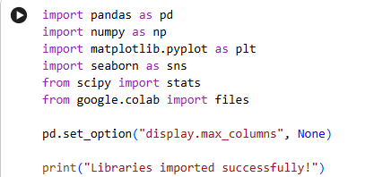
RESULTS
Import Libraries
The required Python libraries were imported to support data loading, preprocessing, statistical analysis, numerical computation, and visualization of the agricultural dataset.
Pandas – Data manipulation and analysis
NumPy – Numerical computations
Matplotlib – Data visualization
Seaborn – Statistical visualization
SciPy – Statistical analysis and hypothesis testing

Slide 7
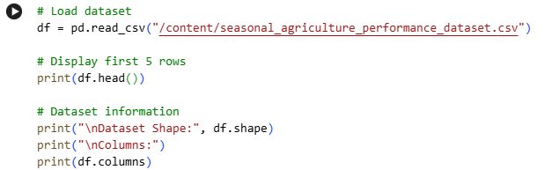
RESULTS
Load Dataset
Dataset: Seasonal Agricultural Performance Dataset Records: 4,000 Features: 28 Analysis: Seasonal, environmental, resource, economic, regional and crop-level analysis

Slide 8
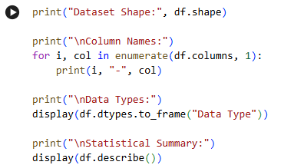
RESULTS
Understand the Dataset
This gives you your Dataset Overview / Descriptive Statistics slide.

Slide 9
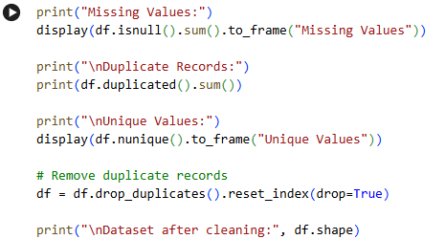
RESULTS
Data Quality and Cleaning
• Checked missing values • Identified duplicate records • Examined data types and unique values • Removed duplicate records where necessary • Prepared data for analysis

Slide 10
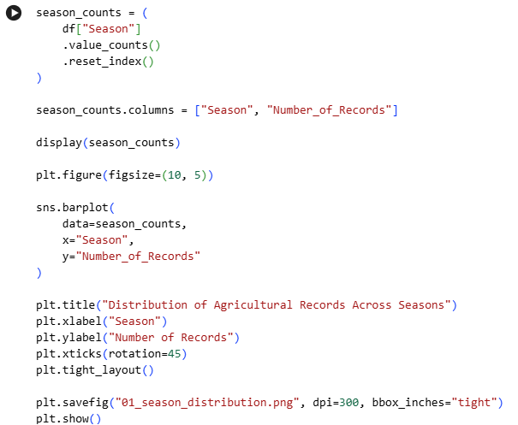
RESULTS
Seasonal Distribution

Slide 11
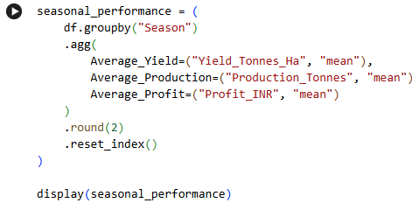
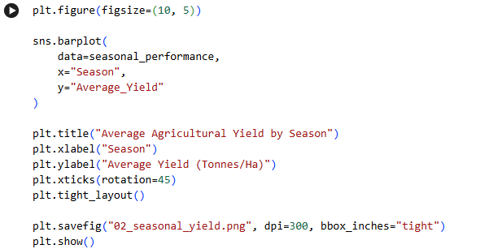
RESULTS
Seasonal Yield, Production and Profit
Yield visualization
Finding: Average agricultural yield varies across seasons, indicating the influence of seasonal conditions on agricultural performance.

Slide 12
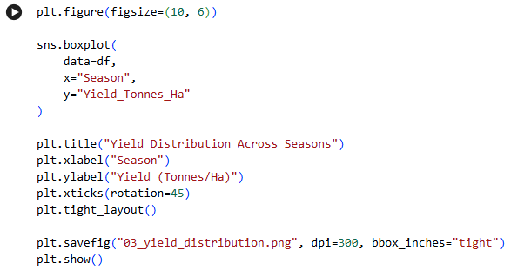
RESULTS
Yield Distribution
Box plot analysis shows the distribution and variation of agricultural yield across different seasons and helps identify unusually high or low observations.

Slide 13
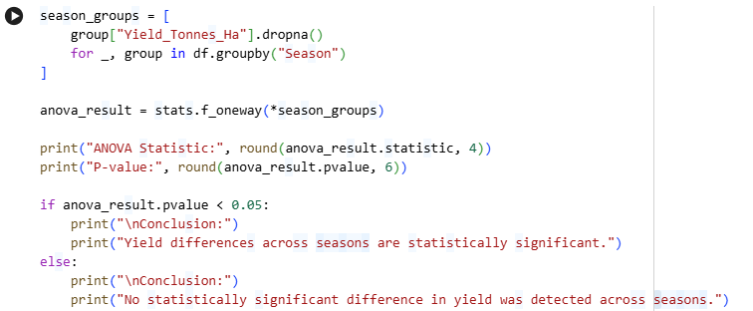
RESULTS
Statistical Significance using ANOVA
ANOVA Test
F-statistic
P-value
Conclusion

Slide 14
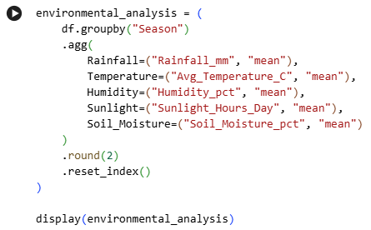
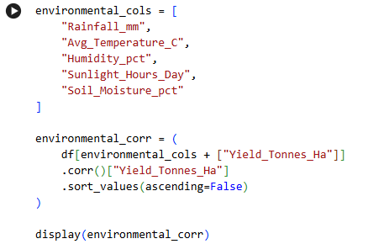
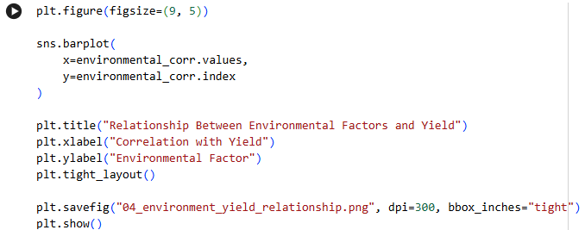
RESULTS
Environmental Conditions Environmental factors vs yield Visualization
Environmental variables show different levels of association with agricultural yield. Correlation analysis helps identify which environmental factors are most closely related to yield.

Slide 15
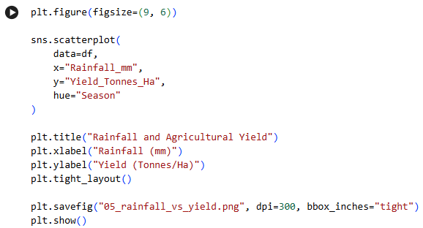
RESULTS
Rainfall vs Yield
The scatter plot examines the relationship between rainfall and agricultural yield across different seasons.

Slide 16
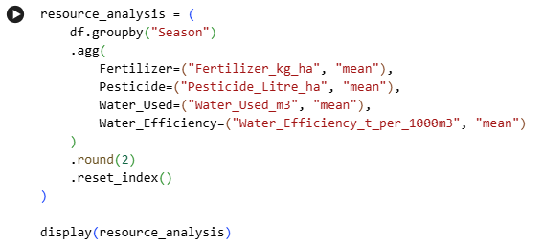
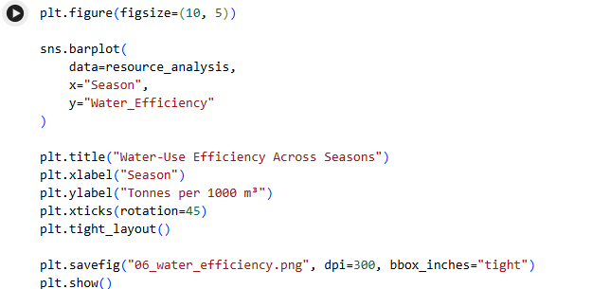
RESULTS
Resource Utilization Water-use efficiency chart
Seasonal comparison reveals variations in water consumption, fertilizer usage, pesticide usage and water-use efficiency.

Slide 17
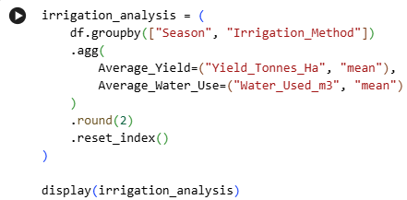
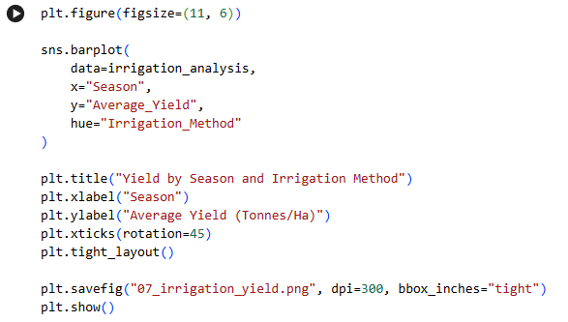
RESULTS
Irrigation Method vs Yield Visualization
Irrigation methods show different yield and water-use patterns across seasons, supporting resource planning and irrigation strategy evaluation.

Slide 18
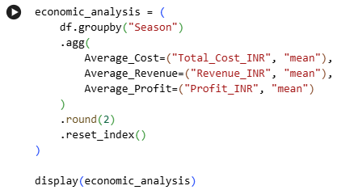
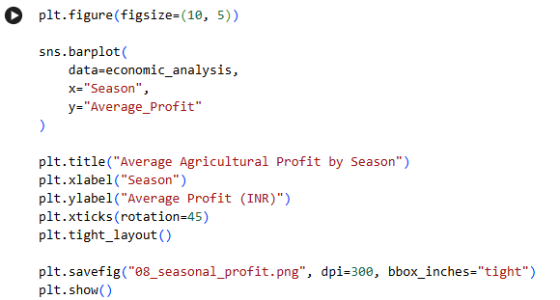
RESULTS
Economic Performance Profit visualization
Economic analysis compares seasonal cost, revenue and profit to identify financially stronger and weaker agricultural periods.

Slide 19
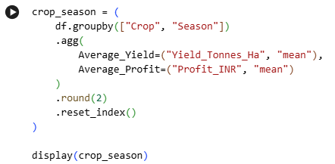
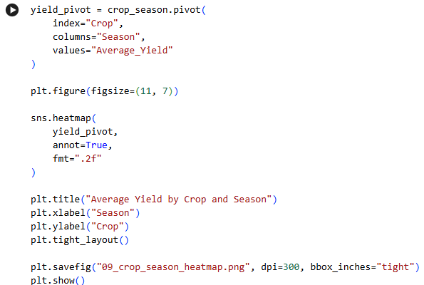
RESULTS
Crop + Season Analysis Heatmap
Crop-season analysis reveals that agricultural performance varies according to the interaction between crop type and season.

Slide 20
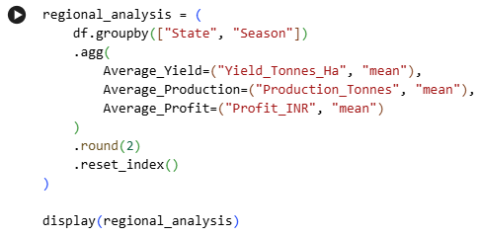
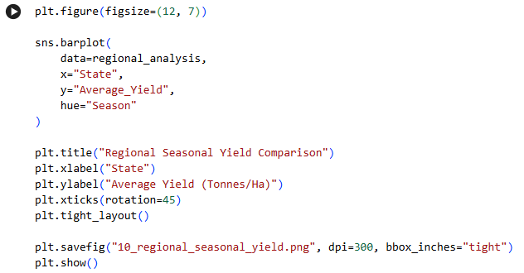
RESULTS
Regional Seasonal Comparison Visualization
Regional analysis identifies differences in seasonal agricultural performance across states, supporting region-specific planning.

Slide 21
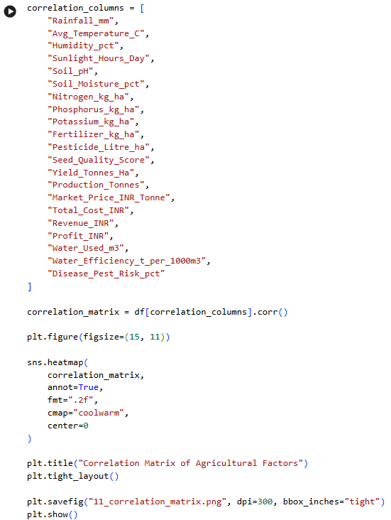
RESULTS
Correlation Analysis
Correlation analysis identifies relationships among environmental conditions, farming inputs, resource utilization, yield, economic outcomes and disease/pest risk.

Slide 22
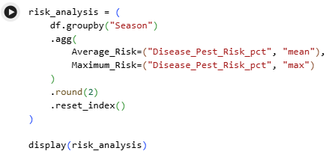
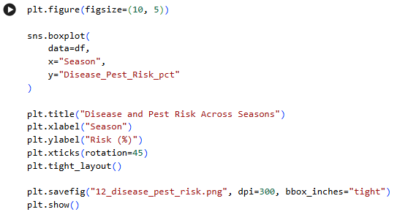
RESULTS
Disease and Pest Risk Visualization
Disease and pest risk varies across seasons, highlighting periods that may require increased monitoring and preventive agricultural planning.

Slide 23
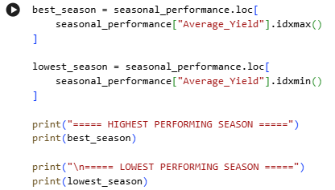
RESULTS
Automatically Find Best and Lowest Performing Seasons
The analysis identifies the highest- and lowest-performing seasons based on average agricultural yield, enabling comparison of seasonal performance.

Slide 24
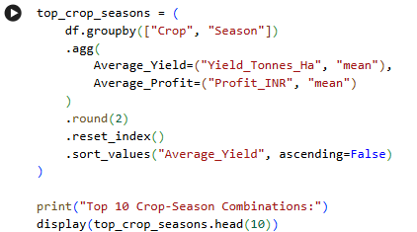
RESULTS
Find Best Crop + Season Combination
Crop-season analysis ranks crop and season combinations based on average yield and profit to identify the most promising combinations.

Slide 25
RESULTS
Unusual & Significant Observations
The analysis identified notable variations in agricultural performance across seasons, crop–season combinations, irrigation methods, regions, and environmental conditions. These variations provide important insights into factors associated with agricultural productivity, resource efficiency, economic performance, and agricultural risk.
The reference code is in the uploaded google colab notebook💻

Slide 26
RESULTS
Key Data-Driven Insights
The analysis generated data-driven insights by comparing seasonal yield, crop–season performance, environmental relationships, irrigation practices, water-use efficiency, economic outcomes, regional variations, and disease/pest risk. These findings provide an evidence-based understanding of agricultural performance and support informed agricultural planning.
The reference code is in the uploaded google colab notebook💻

Slide 27
RESULTS
Using ANOVA for conclusion
Statistical Significance — One-Way ANOVA
A one-way ANOVA test was performed to determine whether the mean agricultural yield differs significantly across seasons. A significance level of 0.05 was used for statistical interpretation.
The reference code is in the uploaded google colab notebook💻

Slide 28
CONCLUSION
The analysis provides a comprehensive assessment of seasonal agricultural performance using yield, production, environmental conditions, resource utilization, economic outcomes, crop–season combinations, regional variations, and disease/pest risk.
The comparative analysis highlights variations in agricultural performance across seasons and identifies important crop–season and regional patterns. Environmental and resource-related factors were also examined to understand their relationship with agricultural productivity.
The findings provide an evidence-based foundation for improving crop planning, resource allocation, water management, risk monitoring, and seasonal agricultural decision-making.

Slide 29
DATA-DRIVEN RECOMMENDATIONS
Based on the analytical findings, the following recommendations are proposed:
Optimize crop selection: Align crop selection with seasons and conditions associated with stronger historical performance.
Improve water management: Use water-use efficiency results to support more effective irrigation planning.
Monitor environmental conditions: Consider rainfall, temperature, humidity, sunlight, soil moisture, and soil characteristics during seasonal planning.
Optimize agricultural inputs: Evaluate fertilizer and pesticide usage according to crop and seasonal requirements.
Strengthen risk monitoring: Increase disease and pest monitoring during seasons or regions showing comparatively higher risk.
Support regional planning: Develop location-specific strategies based on state, district, crop, and seasonal performance.
Use data-driven planning: Combine historical agricultural performance with environmental and economic indicators to support future decision-making.

Slide 30
FUTURE SCOPE
Machine Learning-Based Yield Prediction
Region and season-based crop recommendation
Real-Time Weather Integration
Interactive agricultural analytics dashboard
Disease, resource-use, and market-price forecasting
Scalable Agricultural Decision-Support System
Market Price Forecasting

Slide 31
GITHUB LINK
https://github.com/its-nishar/Seasonal_Agriculture_Performance_Analysis.git
Project Repository Complete source code, dataset, analysis, visualizations, and project documentation are available in the GitHub repository.
Repository Includes:
📓 Google Colab
📊 Agricultural Dataset
📈 Data Visualizations
🔍 Exploratory Data Analysis
📋 Statistical Analysis
💡 Key Insights & Recommendations
📖 Project Documentation

Slide 32

VOIS COURSE COMPLETION CERTIFICATE - COURSE NAME- DATA VISUALIZATION

Slide 33
THANK YOU FOR YOUR TIME & ATTENTION
Seasonal Agriculture Performance Analysis Data-Driven Insights for Better Agricultural Planning
.
.

